Slide 1

rate prediction
By
Pavan
Sreenu
Sagar

Slide 2

Contents
Problem statement
Introduction
Machine learning
Multiple linear Regression
Conclusion

Slide 3

Problem statement
Finding out the future prediction of crime rate for robberies by using Machine learning algorithm using python as core.

Slide 4

Introduction
The crime rate has been increasing day by day so it is
need to solve cases in faster way.
So we need to use technology and help the police departments to decrease the crime rate
Here we have used machine learning to help the police department for decreasing crime rate in the future years
Here we used multi-linear regression algorithm for predicting the future crime rate.

Slide 5

Machine Learning
Machine learning is an subset of artificial intelligence (AI) that provides systems the ability to automatically learn and improve from experience without being explicitly programmed. Machine learning combines the data and statistical tools to predict output. The machine receives data as input , use an algorithm to formulate answers . Machine Learning is also used for a variety of task like fraud detection and predictive maintenance.

Slide 6

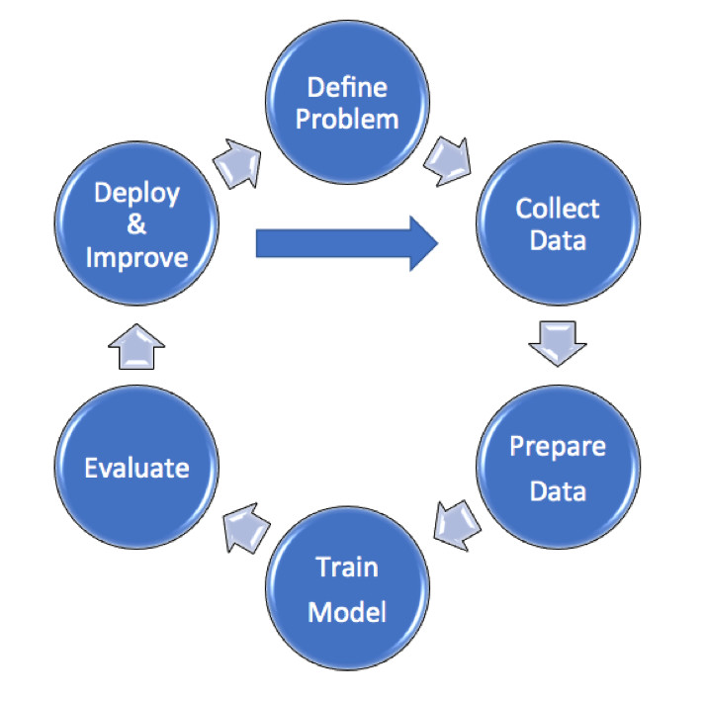
Steps
1.Data collection
2.Data wrangling
3. Analyse the data
4.Train the algorithm
5.Test algorithm
6. Deployment

Slide 7

Multiple linear regression
Multiple linear regression is the most common form of linear regression analysis. As a predictive analysis, the multiple linear regression is used to explain the relationship between one continuous dependent variable and two or more independent variables. The independent variables can be continuous or categorical (dummy coded as appropriate). Here it consist of hyperplane i.e is all the straight lines joined together is called hyperplane. The iterations are performed upto a0=0. The equation of the multiple linear regression y=a0+a1*x1+a2*x2........

Slide 8

Conclusion
As we conclude that with the help of machine learning technology, it has become easy to find out relation and patterns among various data’s. The work in this project mainly revolves around predicting the future crime rate. Using the concept of machine learning we have built a model. We generated the future crime rate value which helps the police departments and central bureau of investigation and crime departments to decrease the crime rate in that years.

Slide 9
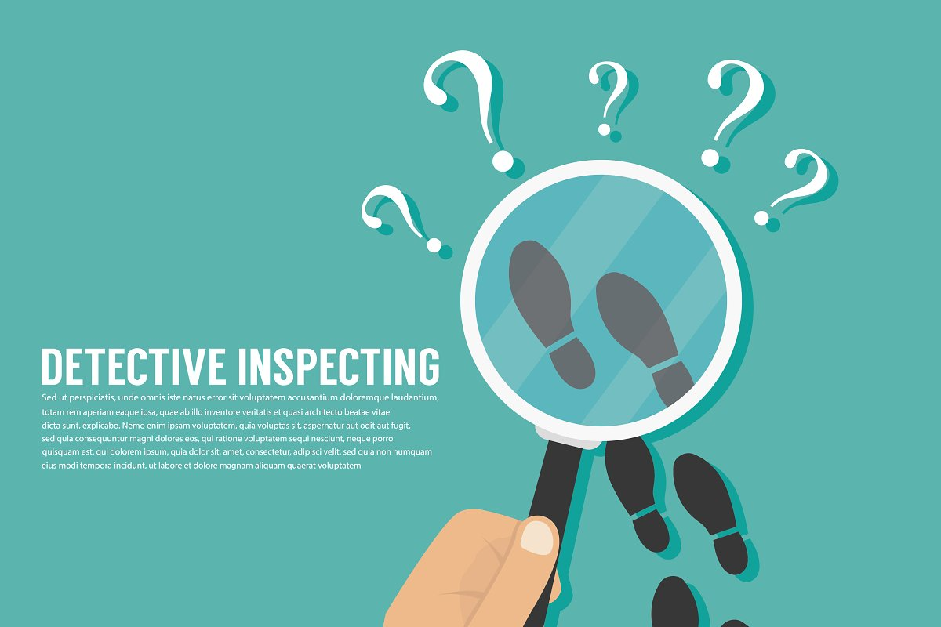
Any Queries

Slide 10

Thank you

